Slide 1

UN/CEFACT Project Information Session
Critical Raw Material Supply Chain
Traceability & Sustainability
June 15, 2023
Notes:
The United Nations Centre for Trade Facilitation and Electronic Business (UN/CEFACT) is a subsidiary, intergovernmental body of the United Nations Economic Commission for Europe (UNECE) which serves as a focal point within the United Nations Economic and Social Council for trade facilitation recommendations and electronic business standards. It has global membership and its members are experts from intergovernmental organizations, individual countries' authorities and also from the business community.
UN/CEFACT role & capabilities to deliver digital standards for sustainable supply chains

Slide 2




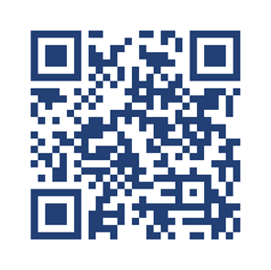
Nancy Norris
Senior Director,
ESG & Digital Trust
Government of British Columbia
Nancy.Norris@gov.bc.ca

Slide 3


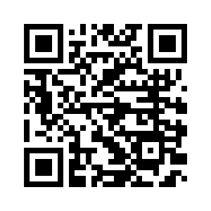
Steve Capell
Managing Director
Go Source Pty Ltd.
Steve.Capell@gmail.com

Slide 4


Purpose
Provide additional information about the UN/CEFACT Critical Raw Material Traceability project.
Answer questions about participation, timelines, and next steps.
Notes:
To provide additional information and answer questions about the UN/CEFACT Critical Raw Materials Supply Chain Sustainability and Traceability project.
To outline project objective, background, deliverables, types of participation, timelines and next steps.

Slide 5

Agenda
PART 1
PART 4
Welcome and Introduction
Review of Project Deliverables
PART 2
PART 5
Energy & Mines Digital Trust - Background
Project Participation, Timeline, and Next Steps
PART 3
PART 6
UN/CEFACT Textile Project - Background
Questions and Discussion

Slide 6




Principles
Consensus-Driven & Collaborative
Practical
The project will define and deliver practical ways to add value.
We will build useable tools that facilitate global implementations.
The UN/CEFACT Open Development Process is consensus driven, collaborative, open and transparent.
Strategically Aligned
Informed
We will build upon work already completed and underway by UN/CEFACT and other organizations and initiatives.
This project is aligned with the UN Sustainable Development Goals.
Notes:
UN/CEFACT Code of Conduct - https://digitallibrary.un.org/record/600433?ln=en

Slide 7



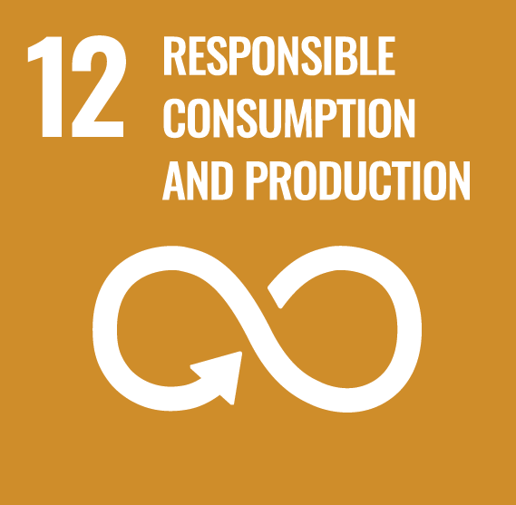
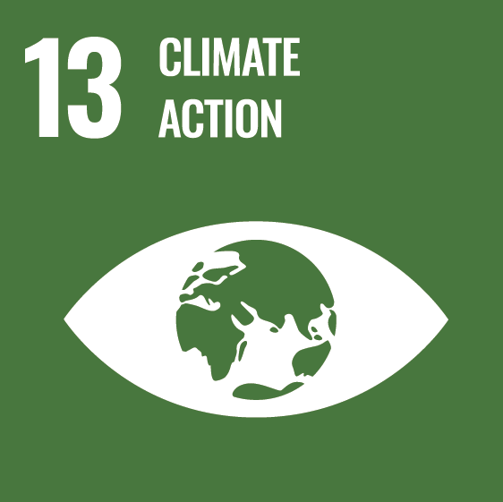
Sustainable Development Goals
Notes:
The 2030 Agenda for Sustainable Development outlies 17 Sustainable Development Goals (SDGs). The CRM project supports the delivery of several key SDGs.
#7: Affordable and Clean Energy: By reducing the barriers to ESG compliance, this project makes affordable, sustainable energy more attainable.
#9: Industry, Innovation and Infrastructure: Higher technology industries are more resilient in a crisis, and this project supports technical innovation in CRM supply.
#11: Sustainable Cities and Communities: Digital credentials present a source of verified, trustworthy information. More accurate data regarding GHG emissions and other air pollution will allow cities to better understand their progress towards climate goals.
#12 Responsible Consumption and Production: Digital credentials streamline the process of sustainability reporting. Tamper-proof to manipulation, digital credentials provide a source of trustworthy information, even when shared across complex supply chains.
#13: Climate Action: Over recent years, the realization has surfaced that we cannot continue with old ways and expect to see improvement. New ideas, tools, and technology are essential to collective climate action.

Slide 8
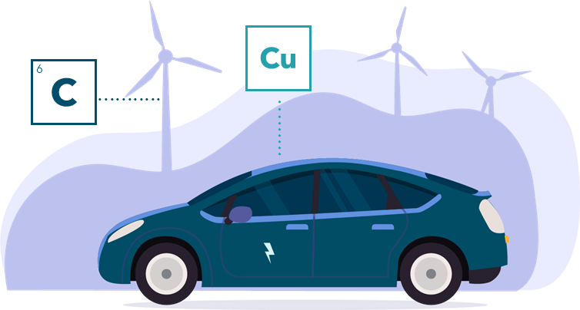
CRM
Project Goal
Uplift critical raw material supply chain resilience and sustainability
Notes:
Demand for nickel, copper, and cobalt to produce electric vehicle batteries is expected to increase by 14x, 10x and 3x, respectively, by 2030, according to BloombergNEF.
This project aims to uplift critical raw material supply chain resilience and sustainability.

Slide 9


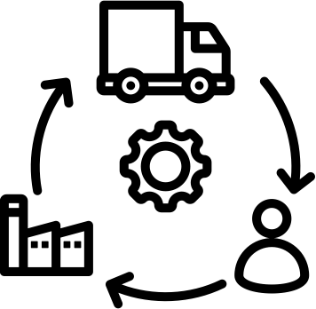



Resilient & Sustainable Supply Chains
Traceability & Transparency Tools
Critical Raw Materials
Notes:
Critical Raw Materials: are part of our daily lives and paramount to the functioning of our industrial ecosystems (digital, transport, construction, renewable energy technologies, lightweight); for instance, tungsten in phones, lithium in batteries, gallium and indium in LED lamps, rare-earth elements in magnets for digital technologies, electric vehicles and wind generators.
Such minerals are “critical” as they represent the most economically important raw minerals with a high supply risk and are concentrated in few geographical areas. Considering cost-benefit aspects and a risk-based approach (for CRMs sourced in conflict-affected states), traceability and transparency tools will be key to support sustainable, resilient and resource-efficient of CRMs.
Transparency and traceability would also support addressing unintended consequences, social and environmental sustainability-related issues stemming from heavy metal pollution, resource depletion and habitat destruction.

Slide 10





Challenges
Growing Demand for CRMs
Growing Demand for Trusted ESG Disclosure
Lack of ESG Harmonization
Lack of Technical Interoperability
Need for Global Perspective
Notes:
Growing Demand for CRM: For example, demand for nickel, copper, and cobalt to produce EV batteries is expected to increase by 14x, 10x and 3x, respectively, by 2030, according to BloombergNEF
Growing Demand for ESG Disclosure: From both investors and consumers, and increasingly regulators
Lack of ESG Standardization: A complex and evolving landscape of bodies regulate, set standards, certify and rate ESG performance internationally
Lack of technical interoperability: Many traceability solutions exist. Interoperability is needed to port data between them along an entire supply chain
Need for Global Perspective: Supply chains are global but ESG data is held in regional and corporate “islands”

Slide 11










Lack of ESG Harmonization
Regulations
Standards
Certifications
Rankings

Slide 12
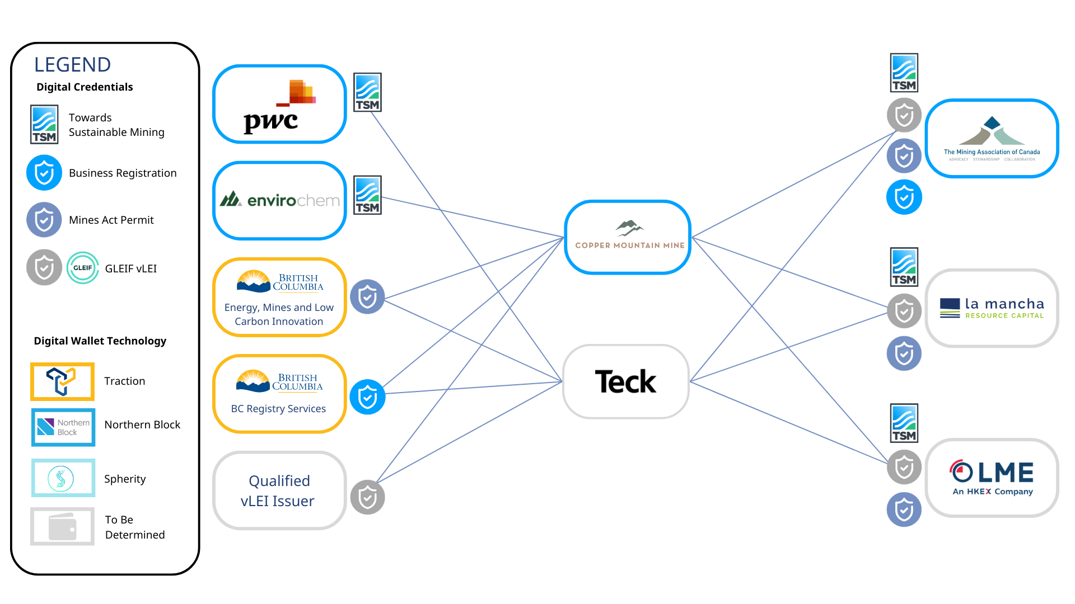


Slide 13
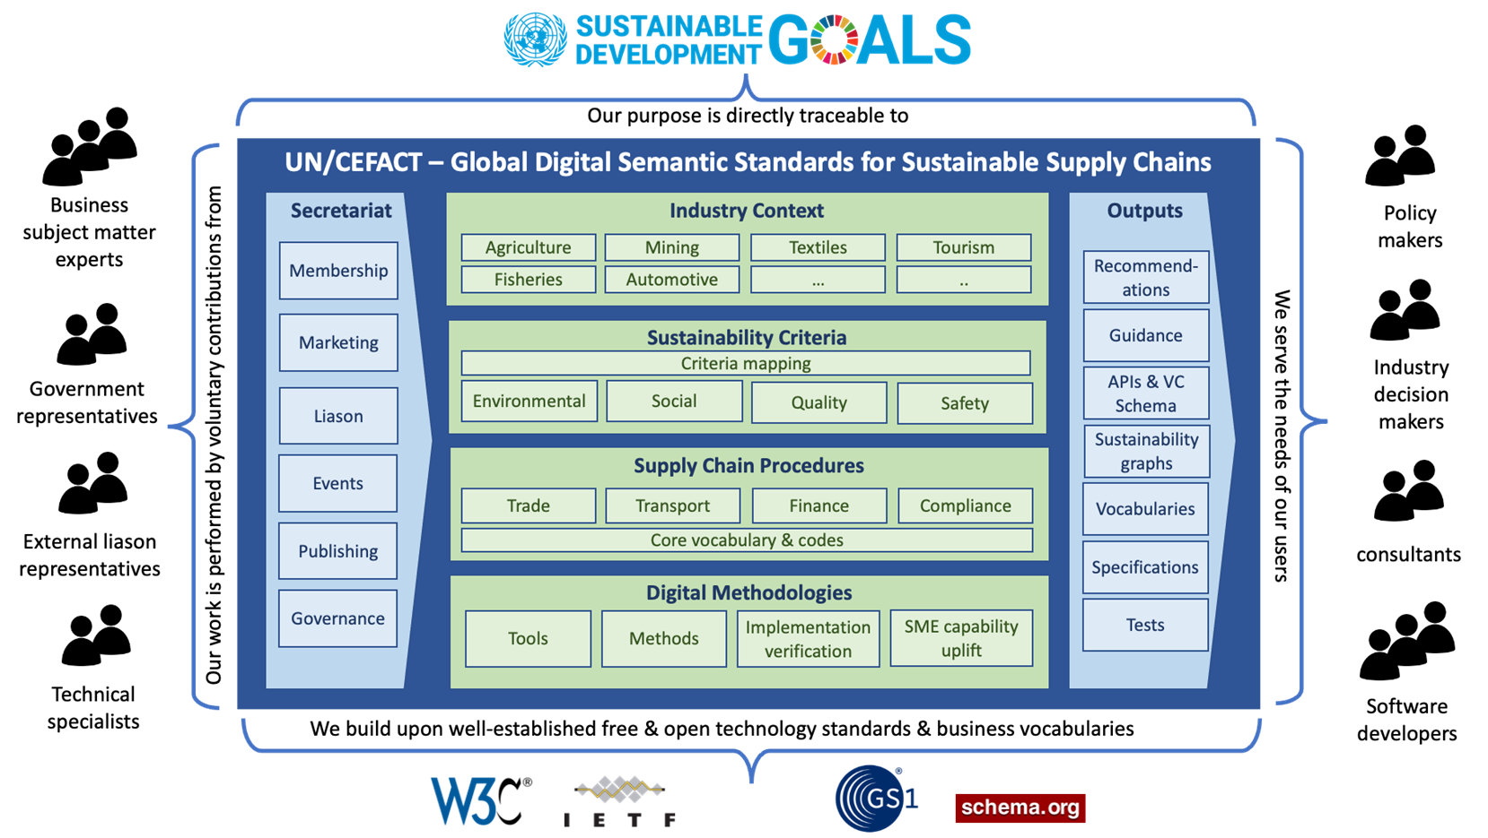

Slide 14

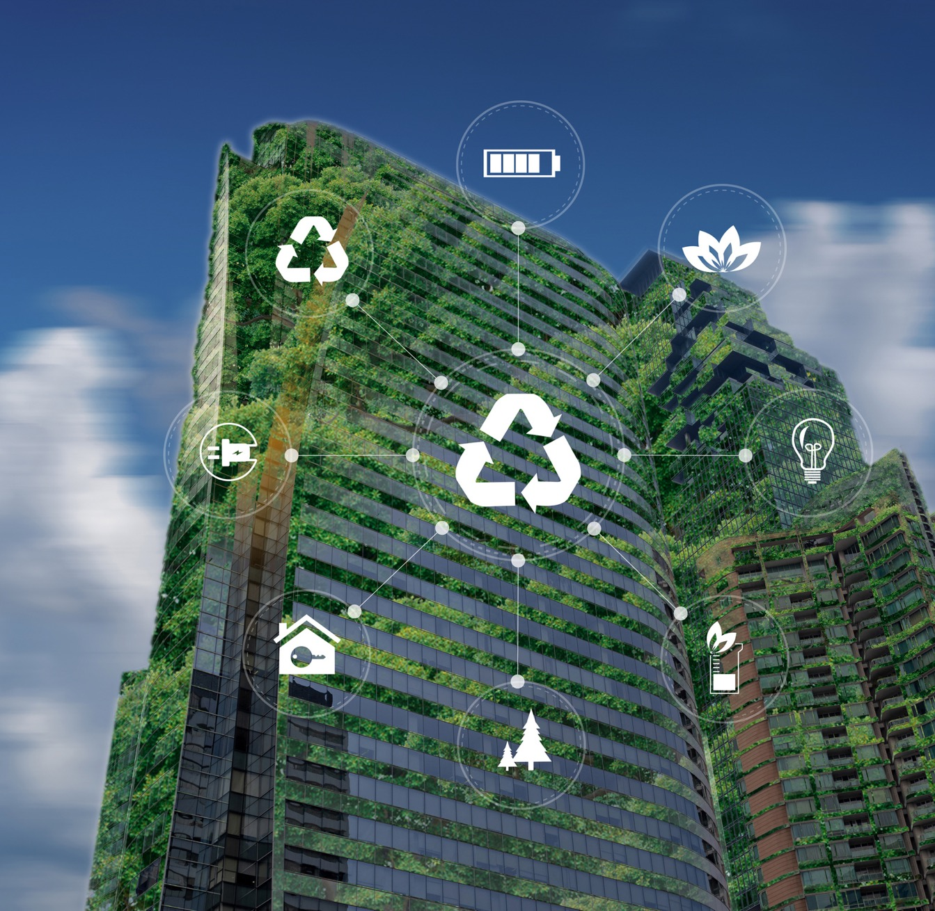
Why Traceability & Transparency Matters
59%
Of environmental claims are not backed by evidence. 42% were deemed deceptive.
68%
Of executives admit their company is guilty of greenwashing.
78%
Of consumers believe that companies should be environmentally responsible.
https://www.un.org/sites/un2.un.org/files/high-level_expert_group_n7b.pdf
https://ec.europa.eu/commission/presscorner/detail/en/ip_21_269
https://www.fastcompany.com/90740501/68-of-u-s-execs-admit-their-companies-are-guilty-of-greenwashing
https://blog.gitnux.com/greenwashing-statistics/
https://www.un.org/en/delegate/%E2%80%98zero-tolerance-greenwashing%E2%80%99-guterres-says-report-launch
Notes:
As regulatory and consumer pressures drive up demand (and justify premium prices) for sustainable goods, so the commercial incentive to make fake sustainability claims will increase
EC investigation : 59% of environmental claims had no evidence and 42% were deemed false or deceptive.
Fast Company: 68% of executives admit their company is guilty of greenwashing.
Survey: 78% of consumers believe that companies should be environmentally responsible and are willing to pay premiums for confidence in those claims.
Secretary General Guterres at COP27 2022 : “Zero Tolerance for Greenwashing”

Slide 15


Consequences of Greenwashing
A Race to the Top
A Race to the Bottom
It is hard to fake claims
Consumer confidence improves
Higher prices are justified
Business is motivated to make provable claims
It is easy to fake claims
Consumer confidence drops
There’s no price differential
Well-intentioned businesses fake claims to compete
Notes:
There is already a significant difference between consumer expectation and market behaviour. There are two plausible pathways out of this:
A Race to the Top – Greenwashing is rare and has nowhere to hide.
A Race to the Bottom – Greenwashing is ubiquitous and undetectable.
We should be motivated to make it hard to fake claims! That is the focus of this presentation.

Slide 16




Two Years on Textile & Leather Traceability
Policy Makers
Industry Actors
Regulations and Standards
Inclusive global Ecosystem
Capacity-building/tech-transfer
Commitment on sustainability
Supply chain collaboration
Investments in technology
Trade and digitalization
Business opportunities
CSOs & Standard Bodies
Technology Providers
Ecosystem integration
Verification and monitoring
Digital validation mechanisms
Visibility of supply chain actors
Scalability to large scale in the industry
Interoperability of IT systems and evolving technologies (blockchain/ AI/ IoT/ etc.)
Notes:
Highlights:
70+ Partners in the value chains
21 countries from developed to emerging economies
Blockchain potential:
Increase trust for sustainability claims
Enhance B2B and B2C communication
Improve access to reliable information
Develop transparency and traceability
Key Findings and Recommendations:
Policy Makers
Regulations and Standards
Inclusive global Ecosystem
Capacity-building/tech-transfer
Industry Actors
Commitment on sustainability
Supply chain collaboration
Investments in technology
Trade and digitalization
Business opportunities
CSOs & Standards Bodies
Ecosystem integration
Verification and monitoring
Digital validation mechanisms
Visibility of supply chain actors
Technology Providers
Scalability to large scale in the industry
Interoperability of IT systems and evolving technologies (blockchain/ AI/ IoT/ etc.)

Slide 17






Implementation: 70 Partners & 21 Countries
250+ Project Experts
33+ Consultation Meetings
2000+ Participants
900+ Experts in the Wide Network
70+ Partners in Blockchain Pilots
30+ Countries
190,000+ Companies
Notes:
We just spent 2 years working on textile and leather traceability
At UNECE, starting in 2019 we have set-up a multi-stakeholder policy dialogue platform to engage with experts from the whole industry ecosystem.
Extensive consultation (here you have figures), made it clear that traceability and transparency need to be advanced through policies and norms, standards that define the business and data model, and innovation in new technologies like blockchain and markers.
During the first phase of the project we have produced these tools, as a result of an intergovernmental process, which are the UN policy recommendations and standards for traceability and transparency of sustainable value chains in the industry.
And are now starting training on the use of the standard and the blockchain system.
THE TOOLBOX:
Policy Recommendation and Call to Action – Adopted in April 2021
Traceability & Transparency Standards & Guidelines – Adopted in April 2021
Blockchain Pilots & Capacity Building – Ongoing
Project website: https://unece.org/trade/traceability-sustainable-garment-and-footwear

Slide 18
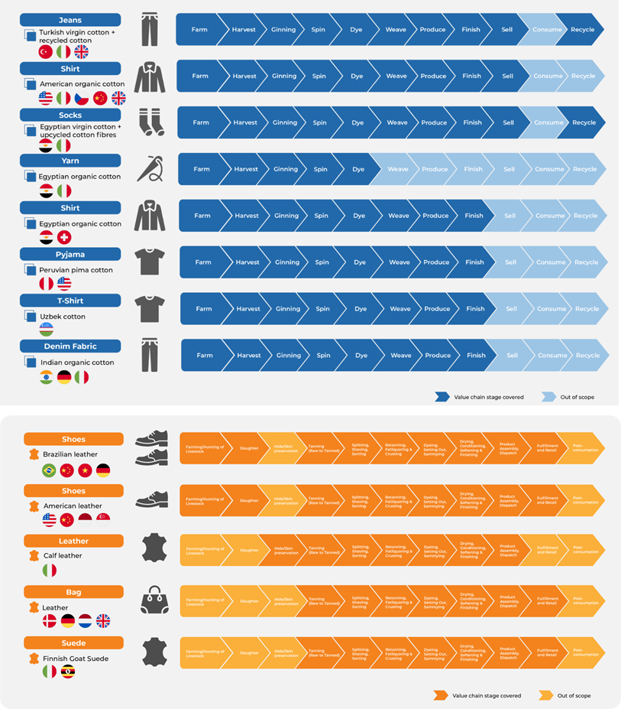
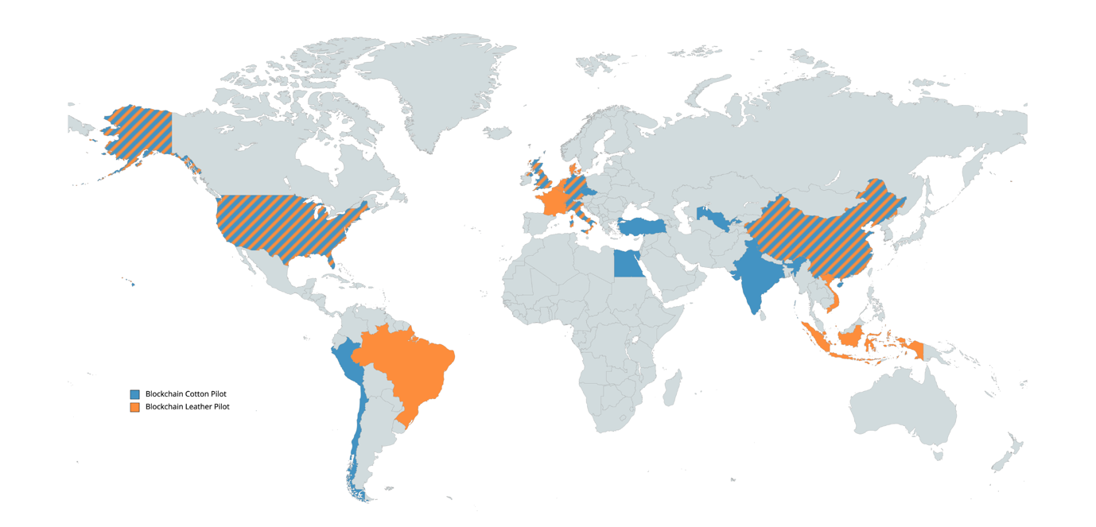
Overview of Products' Use Cases and Value Chain Coverage
Blockchain Cotton and Leather Pilot
Kristal Bosworth
Public Relations Manager, PR Team
Notes:
A complex Global Process
New and advanced technologies, like DLT blockchain, are promising.
They allow for verifiable tracking and tracing of any product, from origins through every stage of production, to the end of its journey and can improve market access for SMEs that have embraced sustainability and demand a level playing field.
How are exploring the role we supporting at UNECE?
We have developed a blockchain system to test our TT approach/standard to help the identification and coding of the key data entities that need to be collected and exchanged by all value chain actors at critical data points in order to assess the sustainability performance of products, processes and facilities, and to support claims about origin and sustainability performance.
In order to onboard partners and their supply chain actors we have developed and implementation toolkit, which covers how the data is handled, an onboarding packaged with methodology and steps covered in the pilot, a Traceability and Transparency matrix for data collection as well a a Blockchain Platform user manual.
We have now more than 70 partners in two pilots for cotton and leather - brands, manufacturers, cotton cooperative, farmers, standard setting bodies, DNA markers involved across 21 countries including Egypt, Italy, Switzerland, Denmark, UK, USA, Peru’, China, Uzbekistan, etc.
Concluding sentence
Transformation happens not with a tiny minority getting committed, but when the silent majority gets swept along, and we need to provide that silent majority with supporting framework and toolbox for that.

Slide 19

Lessons Learned
CRM
Project Goal
We learned some lessons and encountered challenges.
Let’s look at six of them.
Uplift critical raw material supply chain resilience and sustainability

Slide 20

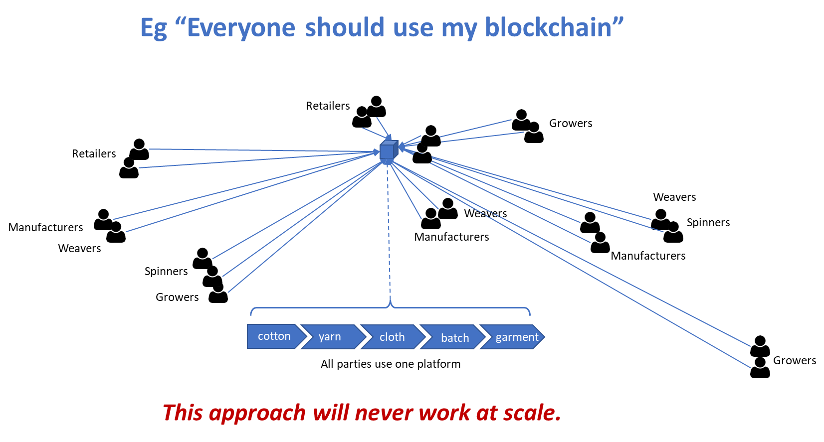
Challenge #1: Centralized Solutions Can't Scale
Notes:
Challenge #1 – Centralised Solutions Can’t Scale.
EG: “Everyone should use my blockchain” – this approach will never work at scale.

Slide 21
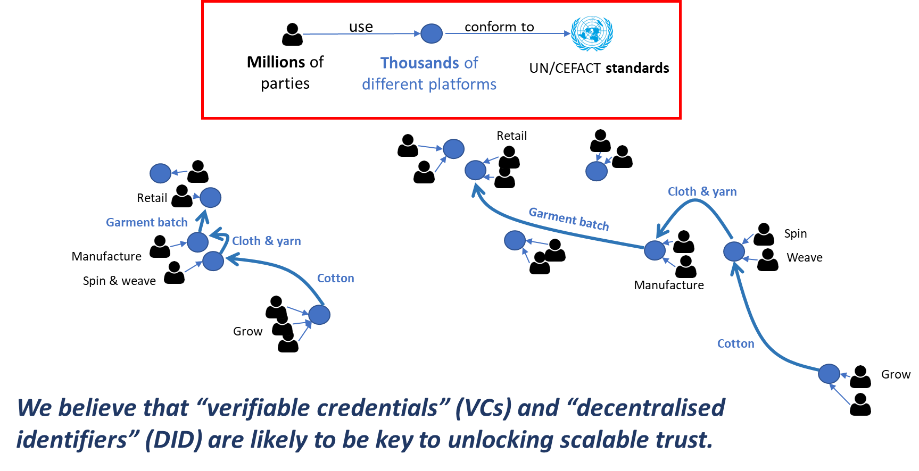
Focus on Decentralisation
Notes:
Challenge #1 – Centralised Solutions Can’t Scale.
EG: “Everyone should use my blockchain” – this approach will never work at scale.

Slide 22

Challenge #2: Transitioning from a Paper-based World
Paper rendering of digital credentials that allow digital data to “hop” a paper step.
Large language models to ”make sense” of conformity data that is extracted from paper certificates.
Notes:
If we depend on high digital maturity from all actors in a long supply chain before we can digitise any parts of the supply chain then we’ll be waiting a long time!
We have experimented with paper rendering of digital credentials that allow digital data to “hop” a paper step.
We have also experimented with large language models to ”make sense” of conformity data that is extracted from paper certificates.

Slide 23



Challenge #3:
Managing Commercial Sensitivity
Certifier
Cotton grower
Cotton exporter
Spinning mill
Verification
No Tampering
Not revoked
Authorised Issuer
Redact grower ID
Verify redacted certificate
Issues Organic certificate (identifying the grower)
Presents Organic certificate (identifying the grower)
Forwards Organic certificate (with grower ID redacted)
Kristal Bosworth
Public Relations Manager, PR Team
Notes:
If stakeholders risk revealing sensitive information like prices or customer lists when providing sustainability evidence then they are likely to withhold key sustainability data.
We’ve experimented with selective disclosure protocols for digital credentials.

Slide 24
Challenge #4:
How Can I Trust Your Claims?
No Tampering
DID X
DID Y
DID Z
Not revoked
Accreditation VC
Certificate VC
Issued by Y
Accredited by X
Authority X Issues accreditation VC to Y
Subject Z presents certificate to verifier who follows link and verifies both VCs
Certifier Y Issues certificate VC to Z and includes a link to accreditation
Kristal Bosworth
Public Relations Manager, PR Team
Notes:
A fake certifier might issue “technically valid” credentials. They’ll verify ok but would still be telling lies.
We’ve experimented with linked credentials so that, for example, a certificate is linked to the authoritative accreditation of the issuing certification body.

Slide 25

Challenge #5:
Linking the Digital to the Physical
1.
Product Substitution
2.
Mass
Balance Fraud
Notes:
Digital data is good but what if I can see sustainability evidence, but it’s not about the product I’m buying? For example:
Product substitution. A devious distributor might present high integrity digital proof of sustainability about a specific type of battery – but the actual shipment contains batteries of similar type but not the same origin.
Mass balance fraud. A malicious manufacturer might buy 10 Tons of genuine sustainable and organic cotton and blend it with 90 tons of cheaper un-sustainable cotton – then re-sell the 100 Tons to 10 different clients, re-presenting the same evidence 10 Tons of sustainable cotton evidence to each.
We are aware of istopic marking and other techniques for bulk products. And high integrity tags for manufactured products. Keen for more ideas.

Slide 26

Challenge #6:
What do the Claims
Really Mean?
Sustainability is a global concern but is usually addressed by local entities that follow local standards and regulations.
The International Trade Centre (ITC) has assessed 350 sustainability standards and has mapped them to a harmonised vocabulary.
The challenge here is how to determine whether claims made in one jurisdiction map to criteria demanded by another.
We believe that a harmonised vocabulary will be an important part of our deliverables.
Notes:
Sustainability is a global concern but is usually addressed by local entities that follow local standards and regulations.
The International Trade Centre (ITC) has assessed 350 sustainability standards and has mapped them to a harmonised vocabulary – you can see their work at https://www.standardsmap.org/en/identify.
The challenge here is how to determine whether claims made in one jurisdiction map to criteria demanded by another. For example, how does an Australian climate active certificate map to an EU digital product passport?
We believe that a harmonised vocabulary will be an important part of our deliverables. Keen for your ideas about this challenge.

Slide 27
Additional Resources
Traceability for Sustainable Garment and Footwear
Provides the business requirements and detailed traceability and transparency data models that supported the world-leading work of this team.
UN/CEFACT Implementation Guide E-Certification SPS-part
A white paper that describes how verifiable credentials provides the most scalable, highest integrity, and lowest cost mechanism to achieve traceability (ie join the dots).
UN/CEFACT Web Vocabularies
Provides the semantic vocabulary for the claims to put into your VCs. Use this vocabulary so that others can understand the meaning of your claims.
40th UN/CEFACT Forum: Seminar: The Future of Digital Standards for Sustainable Supply Chains
A collection of presentations on digital standards for sustainable supply chains - from a recent UN/CEFACT forum

Slide 28
Review of Deliverables
Where We’ll Work

Slide 29



Value of Participation
Primary
Producers & Manufacturers
Accreditation Authorities & Certifying Bodies
Software
Providers
Notes:
Primary Producers & Manufacturing Sector:
Decentralization lowers cost of compliance, streamlines business processes, increases market access, and improves profit margins.
Accreditation Authorities/Third-Party Auditors:
As more companies are incentivized to comply with ESG regulation, the need and value of auditors increases. This project will reduce barriers to international data exchange and address discrepancies in ESG regulation between countries.
Audit information can be reused, rather than replaced, as information is exchanged through the supply chain, increasing the value and impact of each audit.
Certifying Bodies/Standards Setters:
This project will make geographically-specific standards mutually recognizable with a global footprint.
Existing ESG standards will increase in value.
Software Providers:
Software providers can increase value to customers if their tools are interoperable and their credentials readable across platforms.
Interoperable software is championed by the UN. Providers will receive greater visibility as the project is adopted at scale.

Slide 30
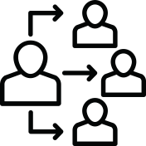


Types of Participation
Observer
Contributor
Implementer
Notes:
Participation in this project is open to any organization. We expect three kinds of participants
Observers who are not active contributors but nevertheless want to maintain a watching brief on our project, or
Active contributors to the development of the digital standards or policy recommendations that are the output of this project, or
Supply chain actors or their software providers that wish be early implementers of the standards defined by this project.

Slide 31
Timeline
TIMING | PROJECT STAGE
MAY 2023 | PROJECT INCEPTION
JUNE 2023 | CALL FOR PARTICIPATION
JULY 2023 | REQUIREMENTS GATHERING
AUGUST 2023 – AUGUST 2024 | DEVELOPMENT OF DRAFT DELIVERABLES
SEPTEMBER 2024 – MARCH 2025 | IMPLEMENTATION TESTING
APRIL – MAY 2025 | PUBLIC DRAFT REVIEW
JUNE 2025 | PROJECT EXIT
AUG 2023 – AUG 2024

Slide 32
Time Commitment
Observer
Contributor
Implementer
AS
NEEDED
4-8 HOURS
PER WEEK
4-8 HOURS
IMPLEMENTATION PHASE
Notes:
This work is voluntary – there is no minimum time commitment.
Generally, the time commitment for each participant type is:
Observer: As needed. Primarily via email and meetings as required.
Contributor: 4-8 hours a week
Early Implementer: 4-8 hours per week during the implementation phase. Implementers are welcome to become contributors at different project phases.
Workload will fluctuate. Some weeks may benefit from additional contribution, while other weeks will require little to no work.
Meetings will be held bi-weekly.

Slide 33

Resilient & Sustainable Supply Chains
Traceability & Transparency Tools
Questions & Discussion

Slide 34



Contact
Nancy Norris
Steve Capell
Senior Director of ESG & Digital Trust
Managing Director
Nancy.Norris@gov.bc.ca
Steve.Capell@gmail.com

